Slide 1
cPanel
A common interface for managing your site

Slide 2
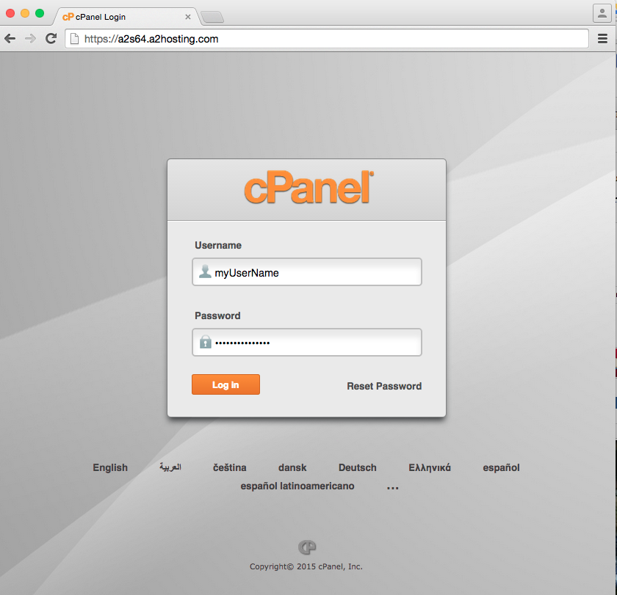
Connecting to CPanel
You will need to have the URL for your cPanel account
Usually a version of your domain name or your hosting service domain name

Slide 3
You will need to have the URL for your cPanel account
Usually a version of your domain name or your hosting service domain name

Slide 4
File Manager
Regardless of the cPanel configuration, every system should have a File Manager.
From the File Manager, search for the public_html (or in some cases, just public) folder.

Slide 5
public_html
Your site will have a lot of files, some that you want people to see, some that you don’t.
Uploading files to the public_html folder should make them viewable to the public

Slide 6
Wait? Why can’t I view my file?
You typed in the wrong URL
When you uploaded the file the transfer didn’t work
When you uploaded the file, it did not have “read access”

Slide 7
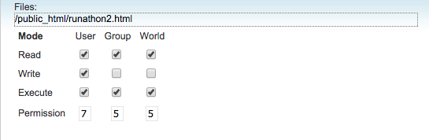
Changing Permissions

Slide 8
Working locally
It is possible to edit your files via cPanel but I don’t do that.
Changes are immediately public
Less opportunity to test and debug

Slide 9
Review
Versions of cPanel often differ depending on if you are using paid or free site
Offers many administrative tools (email accounts, database management, cron jobs)
An alternative is to use sftp to transfer files

Slide 10

Acknowledgements/Contributions
These slides are Copyright 2015- Colleen van Lent as part of http://www.intro-webdesign.com/ and made available under a Creative Commons Attribution Non-Commercial 4.0 License. Please maintain this last slide in all copies of the document to comply with the attribution requirements of the license. If you make a change, feel free to add your name and organization to the list of contributors on this page as you republish the materials.
Initial Development: Colleen van Lent , University of Michigan School of Information

